Slide 1

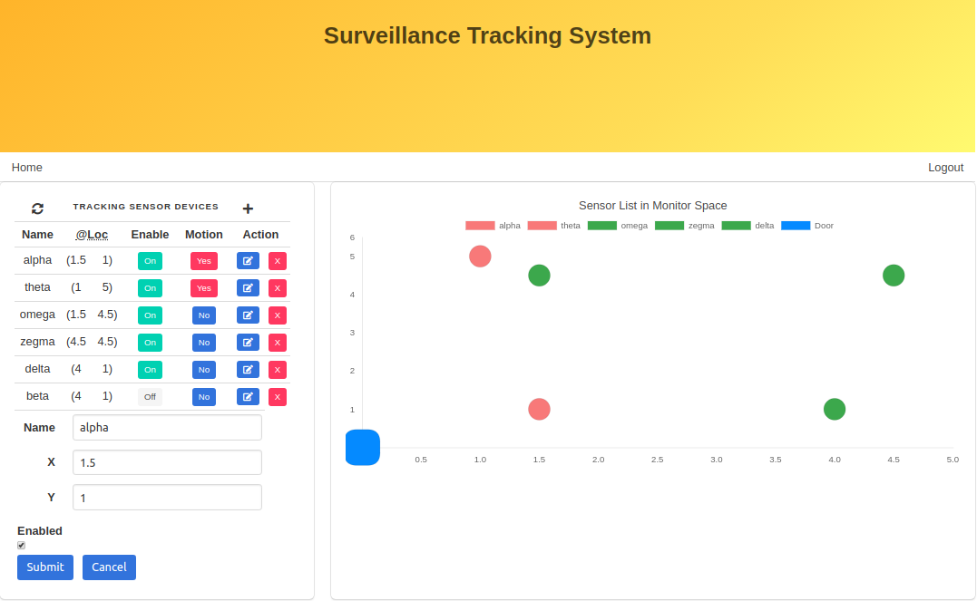
Surveillance Tracking System using IoT
Internet of Talents Christopher Beckett (CB) Fiona Lin (FL) Truong Xuan Nguyen (TN)

Slide 2
Outline
Demo Video
Budget
Challenges
Milestones
Next Steps

Slide 3
Demo Video
Motion Sensor Module
User UI Page

Slide 4
Budget List
Component | Qty | Unit Cost | Sub Total
WeMOS D1 (Rev2) Arduino Compatible | 4 | 8 AUD | 32 AUD
PIR Sensor | 4 | 6 AUD | 24 AUD
Total Cost |  |  | 56 AUD

Slide 5
Achieved Challenges
Send motion detection data to the central server
We were able to detect motion using the PIR sensor, and then send a HTTPS message to the central server, where the state is saved for later query by the UI.

Slide 6
Achieved Challenges
UI to display location information to end user
A sophisticated UI application has been built which allows management of sensor nodes (including creation, edit and deletion), and the display of motion sensor data.

Slide 7
Remaining Challenges
Localization detection algorithms
Final work is being completed on the UI component to enable the processing of motion data to enable the localization of a subject moving through the monitored area.
Final prototype and field deployment
We are working on integrating all the interfaces to produce a complete system. Once the final prototype is ready, efforts will be made to deploy the system into the Final Demo environment.

Slide 8
Localization Methodology
2
Sensors detecting motion | Where is the motion localized?
2 Only | A
1 Only | B
3 Only | C
1 & 2 & 3 | D
1 & 2 | E
2 & 3 | F
A
1
D
3
B
C
E
F
A
Notes:
Chris

Slide 9
Project Plan | Key Milestones
Milestone | Plan | Progression
Select and obtain all hardware | Week 08 | Done
Decide on wireless communications protocol | Week 09 | Done
Build first sensor block | Week 09 | Done
Server ready to receive, aggregate and present data | Week 10 | Done
Backend - Frontend integration | Week 10 | Done
First prototype ready for initial deployment | Week 12 | Done
Final prototype ready for deployment | Week 15 | To do
Deploy final prototype to classroom environment | Week 16 | To do
Complete final report and final presentation | Week 18 | To do

Slide 10
Next Steps
Testing and Debug
Profile the final product performance
Final report and demo app

